Slide 1




Course name: Electrical & Electronics System (EE1002)
B.TECH FIRST YEAR
ACADemic YEAR: 2023-2024
Course code : EE 1002
lecture series no : 02 (one)
Credits : 04
Mode of delivery : oFF line (Power point presentation)
Faculty :
Email-id :
PROPOSED DATE OF DELIVERY:

Slide 2
Session outcome
“Describe the working of Conventional Power Generation. ”

Slide 3
Assessment criteria’S
Assignment
quiz
mid term examination END TERM EXAMINATION

Slide 4

PROGRAM OUTCOMES MAPPING WITH CO1
[PO1]
Engineering Knowledge: Apply the knowledge of mathematics, science, engineering fundamentals, and an engineering specialization to the solution of complex engineering problems.

Slide 5
CONVENTIONAL POWER GENERATION
Lecture No. 2

Slide 6
Contents
Topic:
1. AC GENERATOR
2.Thermal POWER plant
3. Hydel Power Plant
4. Nuclear plants

Slide 7
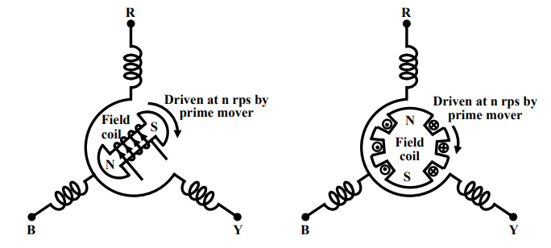
1. AC GENERATOR
A generator has a balanced three phase winding on the stator and called the armature.
The three coils are so placed in space that there axes are mutually 120° apart as shown in Fig 1. 3-phase power is obtained at armature terminals.
Rotor houses a field coil and excited by D.C. The field coil produces flux and electromagnetic poles on the rotor surface.
If the rotor is driven by an external agency, the flux linkages with three stator coils becomes sinusoidal function of time and sinusoidal voltage is induced in them.
However, the induced voltages in the three coils (or phases) will differ in phase by 120° because the present value of flux linkage with R-phase coil will take place after 120° with Y-phase coil and further 120° after, with B-phase coil.
Types of AC generator
Salient pole generator
Non salient pole generator

Slide 8
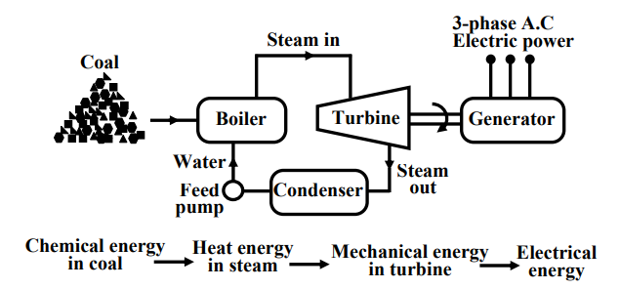
2. Thermal power PLANT
In a thermal power plant coil is burnt to produce high temperature and high pressure steam in a boiler. The steam is passed through a steam turbine to produce rotational motion.
The generator, mechanically coupled to the turbine, thus rotates producing electricity.
Chemical energy stored in coal after a couple of transformations produces electrical energy at the generator terminals as shown in the figure below,
Stringent conditions (such as use of more chimney heights along with the compulsory use of electrostatic precipitator) are put by regulatory authorities to see that the effects of pollution is minimized.
A large amount of ash is produced every day in a thermal plant and effective handling of the ash adds to the running cost of the plant.
Fig. 1 Thermal Power Station

Slide 9
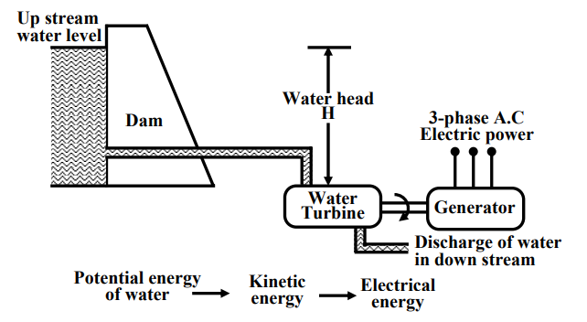
3. Hydel Power Plant
In a hydel power station, water head is used to drive water turbine coupled to the generator. Water head may be available in hilly region naturally in the form of water reservoir (lakes etc.) at the hill tops.
The potential energy of water can be used to drive the turbo generator set installed at the base of the hills through piping called pen stock.
Water head may also be created artificially by constructing dams on a suitable river.
Fig. 2 Hydel Power Plant
In contrast to a thermal plant, hydel power plants are eco-friendly, neat and clean as no fuel is to be burnt to produce electricity.
Running cost of hydel power plants are low, the initial installation cost is rather high compared to a thermal plants due to massive civil construction necessary

Slide 10
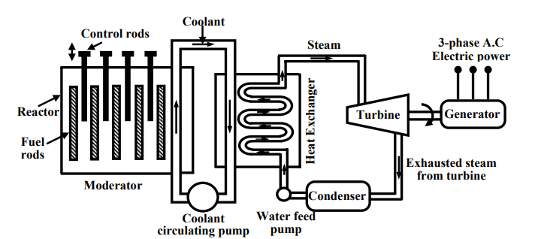
4. Nuclear Power Plant
Atomic power plants work on the principle of nuclear fission of ²³⁵U. In the natural uranium, ²³⁵U constitutes only 0.72% and remaining parts is constituted by 99.27% of ²³⁸U and only about 0.05% of ²³⁴U.
The concentration of ²³⁵U may be increased to 90% by gas diffusion process to obtain enriched ²³⁵U. When ²³⁵U is bombarded by neutrons a lot of heat energy along with additional neutrons are produced.
Fig4. Nuclear Power Plant
These new neutrons further bombard ²³⁵U producing more heat and more neutrons. Thus a chain reaction sets up. However, this reaction is allowed to take place in a controlled manner inside a closed chamber called nuclear reactor.
To ensure sustainable chain reaction, moderator and control rods are used. Moderators such as heavy water (deuterium) or very pure carbon ¹²C are used to reduce the speed of neutrons. To control the number neutrons, control rods made of cadmium or boron steel are inserted inside the reactor.
The control rods can absorb neutrons. To decrease the number of neutrons, the control rods are lowered down further and vice versa. The heat generated inside the reactor is taken out of the chamber with the help of a coolant such as liquid sodium or some gaseous fluids.

Slide 11
The coolant gives up the heat to water in heat exchanger to convert it to steam as shown in figure. The steam then drives the turbo set and the exhaust steam from the turbine is cooled and fed back to the heat exchanger with the help of water feed pump.
The initial investment required to install a nuclear power station is quite high but running cost is low. Although, nuclear plants produce electricity without causing air pollution, it remains a dormant source of radiation hazards due to leakage in the reactor.
Reference: https://archive.nptel.ac.in/courses/108/105/108105053/

